Slide 1
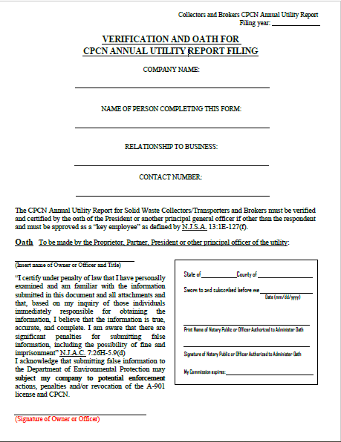
Physical Notary
Example
-This option will require you to scan and upload your physically notarized document to the DEP Submission Portal.
-If during this process you exit the DEP Submission Portal, you will need to log back in to upload your report.

Slide 2
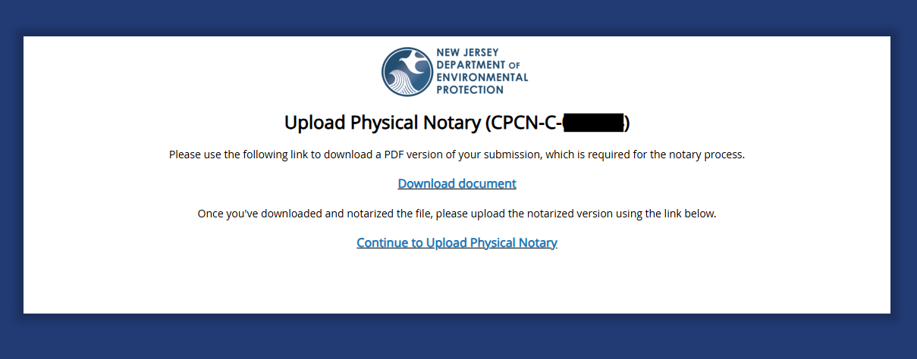
Physical Notary - Step #1
Click on Download document:

Slide 3
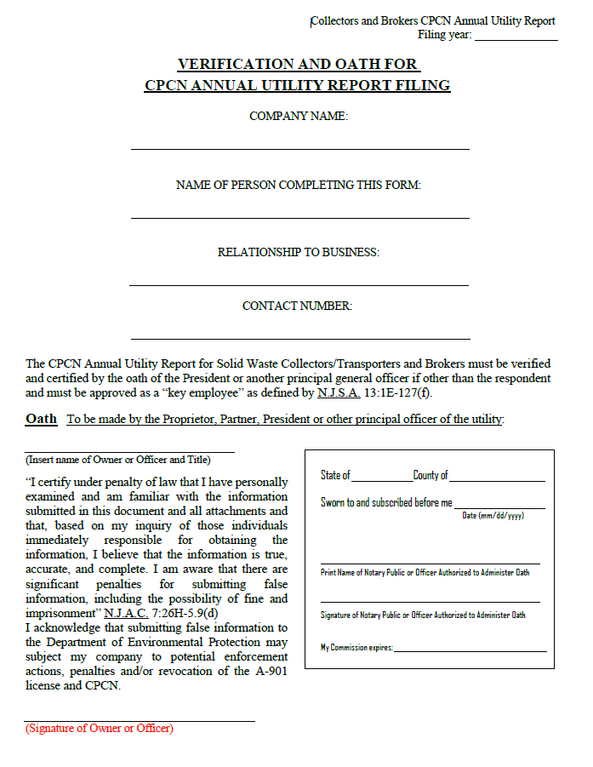
Physical Notary - Step #2
The downloaded document will look like the screenshot to the right:
Please print out, complete, and notarize the document.

Slide 4
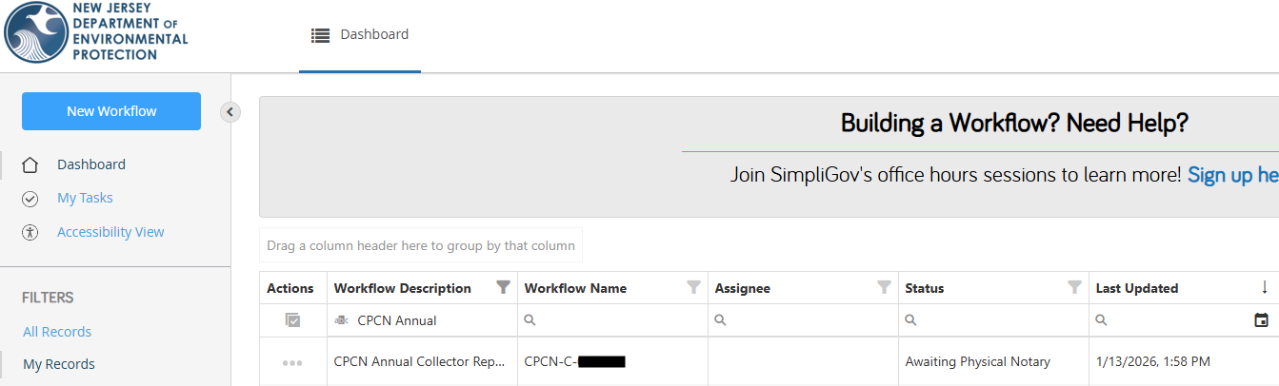
Physical Notary - Step #3
Once the CPCN Annual Utility Report is physically notarized, it must be uploaded to the CPCN Annual Utility Report location found on your DEP Submission Portal. Find the report on your DEP Submission Portal (pictured below) and select your report:

Slide 5
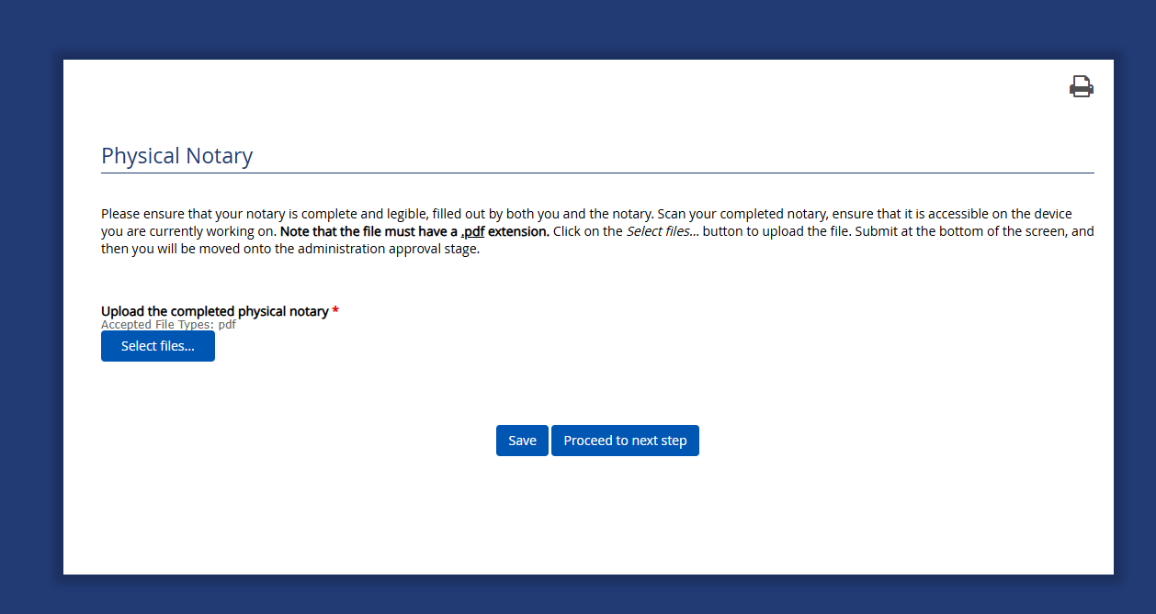

Physical Notary - Step #4
After selecting your CPCN Annual Report “Workflow Name,” you will be directed to the below image. Click “Select files” to upload your scanned physically notarized document:

Slide 6
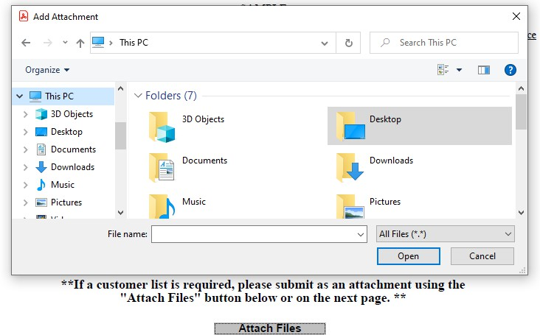
Physical Notary - Step #5
The image below will appear for you to select and upload your scanned physically notarized document. Find the file and select “Open”

Slide 7
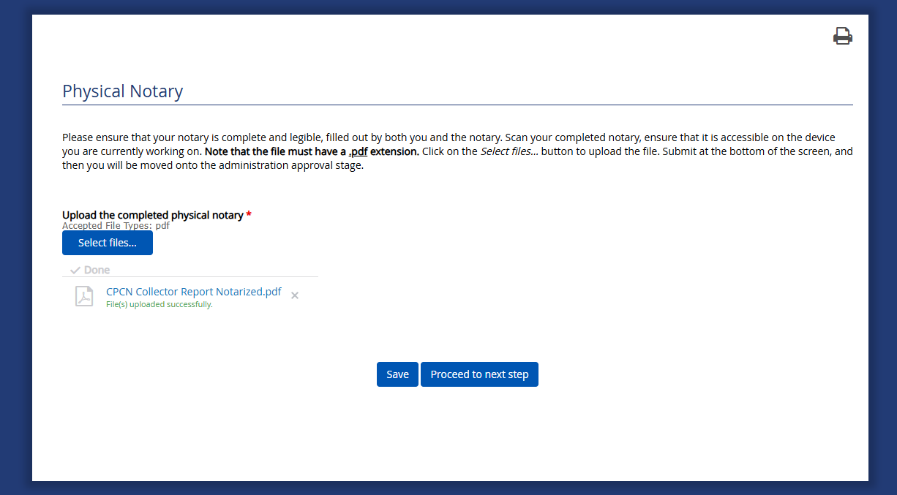
Physical Notary - Step #6
Once you upload your scanned physically notarized document, it will appear as shown below:
Click “Proceed to next step” once you see your file appear, as shown in the picture

Slide 8
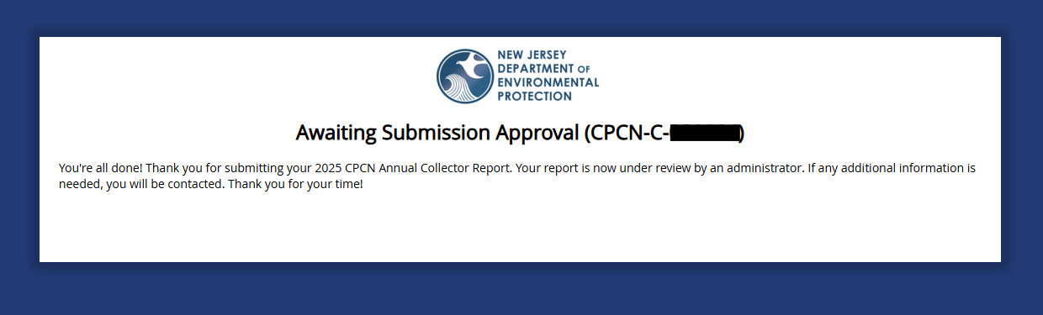
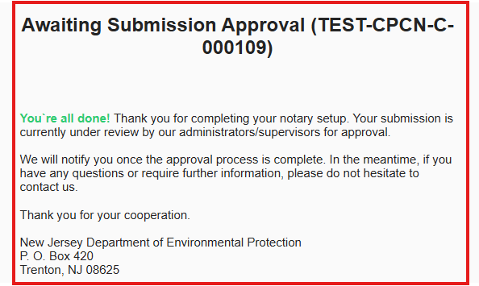
Physical Notary - Step #7
You will receive the following message and email once you’ve completed all steps:
On-Screen Message:
E-Mail Message:

